Slide 1
A Short Introduction about Principal Component Analysis
Junfei Tong & Zhe Zhang
12/07/2016

Slide 2
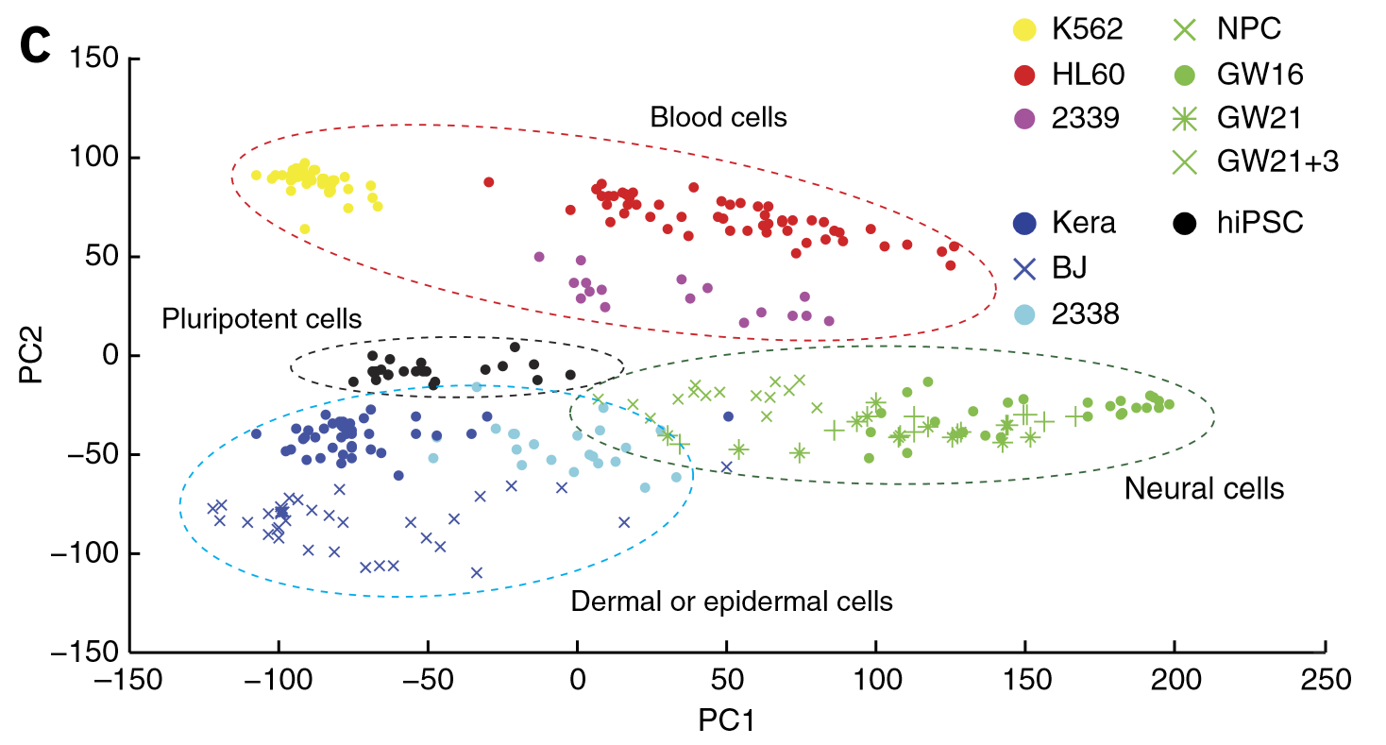
PCA is a method for compressing a lot of data into something that captures the essence of the original data.

Slide 3
Background: Dimension
1 cell = 1-D graph (number line)
2 cells = 2-D graph (normal x/y graph)
3 cells = 3-D graph (fancy graph with depth)
4 cells = 4-D graph (you can’t draw it)
200 cells =200-D graph (etc…)
Are all those dimensions super important? Or are some more important than others?
Notes:
Drawing on the blackboard

Slide 4
Case: 2 cells (and 2 dimensions)
Almost of the variation in the data is from left to right.
Cell 2
Read Counts
Cell 1
Read Counts

Slide 5
If we flattened the data (removed the up/down variation), it wouldn’t look much different.
Cell 2
Read Counts
Cell 1
Read Counts

Slide 6
And if we flattened the data, we could graph it with a number line.
0
5
10
15
20
etc

Slide 7
Hypothetically Speaking… what if we had 2-cell data that looked like this:
2-D
Cell 2
Read
Counts
In this case, we can take 2-D data and display it on a 1-D graph without too much information loss.
Both graphs say, “the important variation is left to right”.
Cell 1
Read Counts
1-D
0
5
10
15
20
etc
Notes:
Each cell we sequence adds another “dimension”
Some dimensions are more important than others…

Slide 8
What does all of this have to do with PCA?
PCA takes a dataset with a lot of dimensions (i.e. lots of cells) and flattens it to 2 or 3 dimensions so we can look at it.
——It tries to find a meaningful way to flatten data by focusing on the things that are different between cells.

Slide 9
A PCA Example
Gene | Cell 1 reads | Cell 2 reads
a | 10 | 8
b | 0 | 2
c | 14 | 10
d | 33 | 45
e | 50 | 42
f | 80 | 72
g | 95 | 90
h | 44 | 50
i | 60 | 50
…(etc) | …(etc) | …(etc)

Slide 10
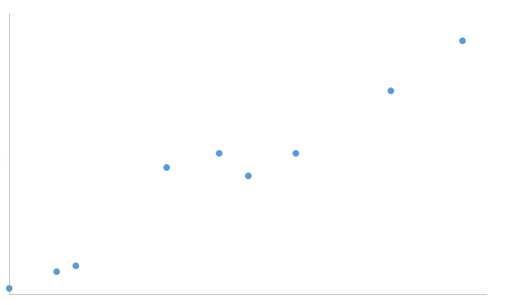
Generally speaking, the dots are spread out along a diagonal line.
Another way to think about this is that the maximum variation in the data is between the two endpoints of this line
Cell 2
Read Counts
Cell 1
Read Counts

Slide 11
Generally speaking, the dots are also spread out along a diagonal line.
Another way to think about this is that the 2 nd largest amount of variation is at the endpoints of the new line.
Cell 2
Read Counts
Cell 1
Read Counts

Slide 12
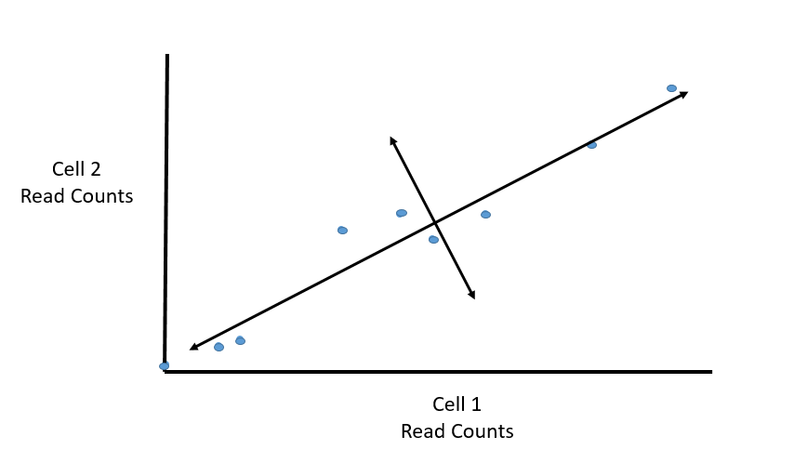
If we rotate the whole graph, the two lines that we drew make new X and Y axes.

Slide 13
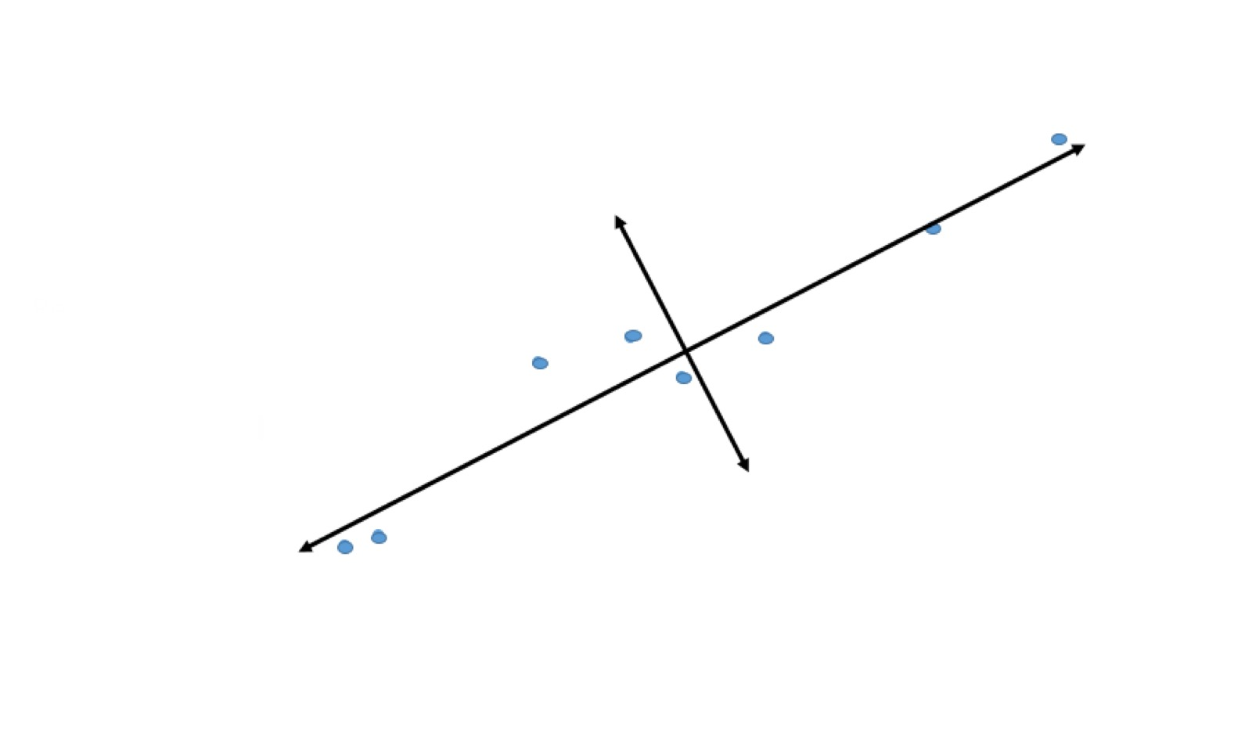
If we rotate the whole graph, the two lines that we drew make new X and Y axes. This makes the left/right, above/below variation easier to see.
1) Tha data varies a lot left to right
2) Tha data varies a little up and down
Note: All of the points can be drawn in terms of left/right + up/down, just like any other 2-D graph.
That is to say, we do not need another line to describe “diagonal” variation-we’ve already captured the two direction that can have variation.

Slide 14
These two “new” (or “rotated ”) axes that describe the variation in the data are “Principal Components”
PC1 (the first principal component) is the axis that spans the most variation.
PC2 is the axis that spans the second most variation.
PC2
PC1

Slide 15
What if we had N cells?
PC1 would span the direction of the most variation.
PC2 would span the direction of the 2nd most variation.
PC3 would span the direction of the 3rd most variation.
PC4 would span the direction of the 4th most variation.
There is a principal component for each dimension (cell).
If we had 200 cells, we would have 200 principal components.
PCN would span the direction of the N^{th} most variation.

Slide 16
PC2- the 2nd most variation in gene expression.
PC1- the direction of the most variation in gene expression.

Slide 17
But this is a plot of cells, not genes? How do we plot cells?

Slide 18
Back to the original scatter plot…
PC1
PC2
Cell 2
Read Counts
Cell 1
Read Counts

Slide 19
The length and direction of PC1 is mostly determined by the circled genes.
PC1
Cell 2
Read Counts
Cell 1
Read Counts

Slide 20
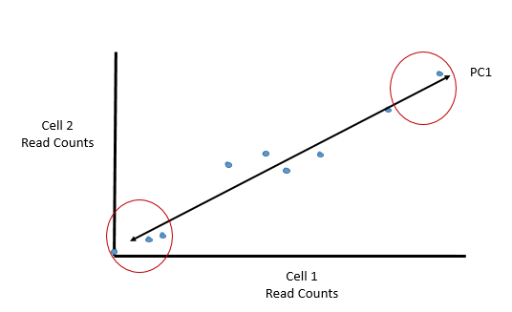
We can score genes based on how much they influence PC1
The length and direction of PC1 is mostly determined by the circled genes.
Gene | Influence of PC1 | In numbers
A | High | 10
B | Low | 0.5
C | Medium | 3
D | Low | -0.2
E | High | 13
F | High | -14
… | … | …
A
B
C
E
D
F
Genes with little influence on PC1 get values close to zero, and genes with more influence get numbers further from zero.

Slide 21
Genes that influence PC2
Gene | Influence on PC2 | In numbers
A | medium | 3
B | high | 10
C | high | 8
D | high | -12
E | low | 0.2
F | low | -0.1
… | …
PC2
A
PC1
C
B
D
F

Slide 22
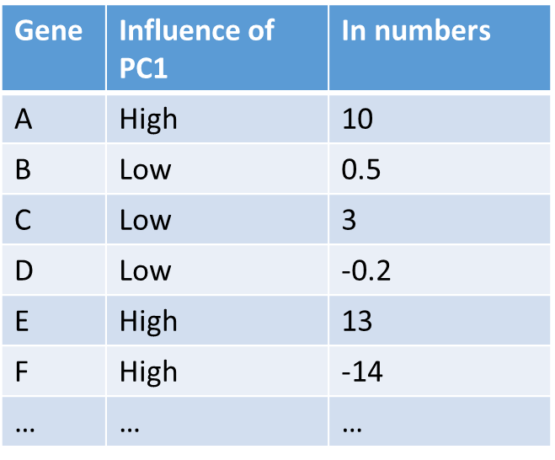
PC1
PC2
Gene | Cell1 | Ce6ll2
A | 10 | 8
B | 14 | 2
C | 33 | 10
D | 50 | 45
E | 80 | 42
F | 95 | 72
… | … | …
Gene | Influence on PC2 | In numbers
A | medium | 3
B | high | 10
C | high | 8
D | high | -12
E | low | 0.2
F | low | -0.1
… | …
Cell1 PC1 score=(read count* influence) +…for all genes
Cell1 PC2 score=(read count* influence) +…for all genes

Slide 23
Hooray! We know how they plotted all of the cells!!!

Slide 24
General ideas
Genes with the largest variation between cells will have the most influence on the principal components.
The 1st PC captures the most variation in the data
The 2nd PC captures the second most variation in the data.
You can use the original data and the first 2 PCs to get X/Y values to plot on a figure. Cells with similar transcription patterns will cluster together.

Slide 25
How to identify key genes?
If we wanted to find out which genes had big influence in putting dermal cells on the left and neural cells on the right, we could look at the influence scores in PC1.

Slide 26
How to identify key genes?
If we wanted to find out which genes help distinguished blood cells from neural and dermal cells, we could look at the influence in PC2.

Slide 27
Terminology Alert
These numbers are weighs for importance of each gene to PC1. In PCA terminology, the weights are called “loadings” and an array of “loadings” for a PC is called an “eigenvector”.
Gene | Influence of PC1 | In numbers
A | High | 10
B | Low | 0.5
C | Medium | 3
D | Low | -0.2
E | High | 13
F | High | -14
… | … | …

Slide 28
PCA Assumption
Based on Euclidean distance between points, which may not be an appropriate distance measure for certain data types (especially counts of abundances)
Assumes a linear relationship between variables, which is not appropriate for certain systems.
If data are non-linear, PCA produces an artifact called the “horseshoe effect”-axis 2 is twisted relative to axis 1 (but it is not a real gradient)

